Slide 1

Decomposition
Chris Piech
CS106A, Stanford University

Slide 2


Karel the Robot
s
* While Karel is in Java, when you program your Karel assignment we ask that you stick to the concepts in the course reader
Notes:
Tomorrow you will learn that Karel is actually a very gentle introduction to programming

Slide 3
Method Definition
private void name() {
statements in the method body
}
This adds a new command to Karels vocabulary

Slide 4
For Loops
public class Place99Beepers extends SuperKarel {
public void run() {
move();
// repeats the code in the “body” 99 times
for(int i = 0; i < 99; i++) {
// the “body”
putBeeper();
}
move();
}
}

Slide 5

While Loops
import stanford.karel.*;
public class BeeperLine extends SuperKarel {
public void run() {
// place a first beeper
putBeeper();
// If the condition passes, run “body”.
// Repeat.
while(frontIsClear()) {
// the “body”
move();
putBeeper();
}
}
}

Slide 6
While Loops
import stanford.karel.*;
public class BeeperLine extends SuperKarel {
public void run() {
// place a first beeper
putBeeper();
// example while loop
while(frontIsClear()) {
move();
putBeeper();
}
}
}

Slide 7
While Loops
import stanford.karel.*;
public class BeeperLine extends SuperKarel {
public void run() {
// place a first beeper
putBeeper();
// example while loop
while(frontIsClear()) {
move();
putBeeper();
}
}
}

Slide 8

While Loops
import stanford.karel.*;
public class BeeperLine extends SuperKarel {
public void run() {
// place a first beeper
putBeeper();
// example while loop
while(frontIsClear()) {
move();
putBeeper();
}
}
}

Slide 9
While Loops
import stanford.karel.*;
public class BeeperLine extends SuperKarel {
public void run() {
// place a first beeper
putBeeper();
// example while loop
while(frontIsClear()) {
move();
putBeeper();
}
}
}

Slide 10
While Loops
import stanford.karel.*;
public class BeeperLine extends SuperKarel {
public void run() {
// place a first beeper
putBeeper();
// example while loop
while(frontIsClear()) {
move();
putBeeper();
}
}
}

Slide 11
While Loops
import stanford.karel.*;
public class BeeperLine extends SuperKarel {
public void run() {
// place a first beeper
putBeeper();
// example while loop
while(frontIsClear()) {
move();
putBeeper();
}
}
}

Slide 12
While Loops
import stanford.karel.*;
public class BeeperLine extends SuperKarel {
public void run() {
// place a first beeper
putBeeper();
// example while loop
while(frontIsClear()) {
move();
putBeeper();
}
}
}

Slide 13
While Loops
import stanford.karel.*;
public class BeeperLine extends SuperKarel {
public void run() {
// place a first beeper
putBeeper();
// example while loop
while(frontIsClear()) {
move();
putBeeper();
}
}
}

Slide 14
While Loops
import stanford.karel.*;
public class BeeperLine extends SuperKarel {
public void run() {
// place a first beeper
putBeeper();
// example while loop
while(frontIsClear()) {
move();
putBeeper();
}
}
}
This is incredibly important!

Slide 15
While Loops
import stanford.karel.*;
public class BeeperLine extends SuperKarel {
public void run() {
// place a first beeper
putBeeper();
// example while loop
while(frontIsClear()) {
move();
putBeeper();
}
}
}

Slide 16
While Loops
import stanford.karel.*;
public class BeeperLine extends SuperKarel {
public void run() {
// place a first beeper
putBeeper();
// example while loop
while(frontIsClear()) {
move();
putBeeper();
}
}
}

Slide 17
While Loops
import stanford.karel.*;
public class BeeperLine extends SuperKarel {
public void run() {
// place a first beeper
putBeeper();
// example while loop
while(frontIsClear()) {
move();
putBeeper();
}
}
}

Slide 18
While Loops
import stanford.karel.*;
public class BeeperLine extends SuperKarel {
public void run() {
// place a first beeper
putBeeper();
// example while loop
while(frontIsClear()) {
move();
putBeeper();
}
}
}

Slide 19
Which Loop
Repeat Process
Know how many times
Don’t know how many times
For Loop
While Loop

Slide 20
If Statement
import stanford.karel.*;
public class IfExample extends SuperKarel{
public void run() {
safeMove();
}
private void safeMove() {
if(frontIsClear()) {
move();
}
}
}

Slide 21
If / Else Statement
import stanford.karel.*;
public class IfExample extends SuperKarel{
public void run() {
invertBeeper();
}
private void invertBeeper() {
if(beepersPresent()) {
pickBeeper();
} else {
putBeeper();
}
}
}

Slide 22
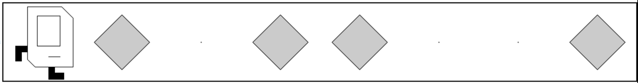

Put it All Together
Before:
After:
Before:
After:

Slide 23
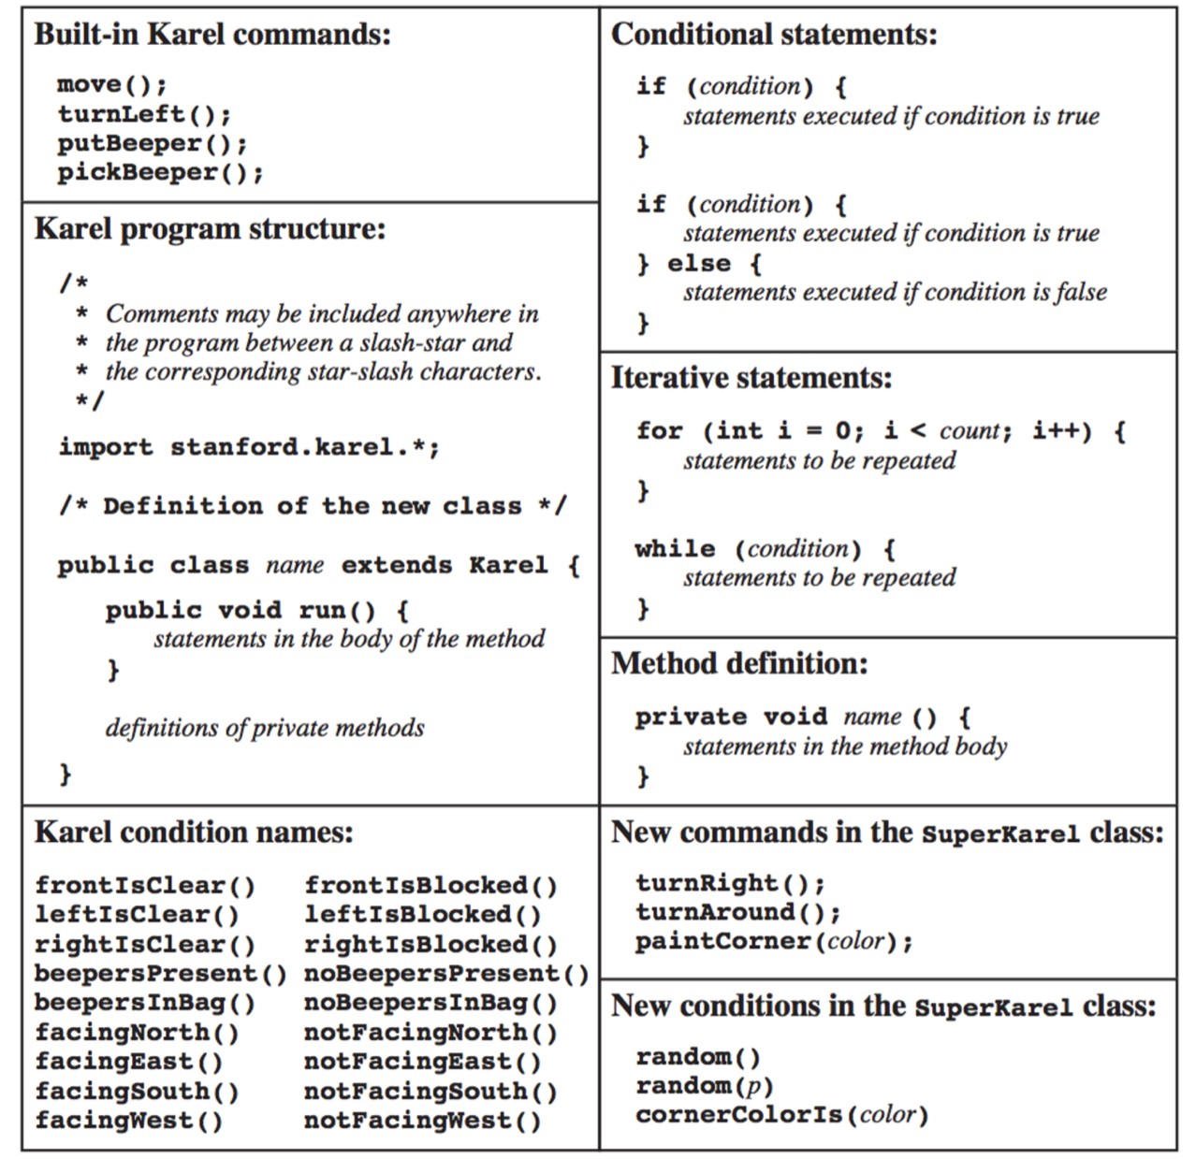
The Full Karel
Today we will use:
frontIsClear()
rightIsBlocked()
beepersPresent()

Slide 24
End review

Slide 25
First, a cool program

Slide 26
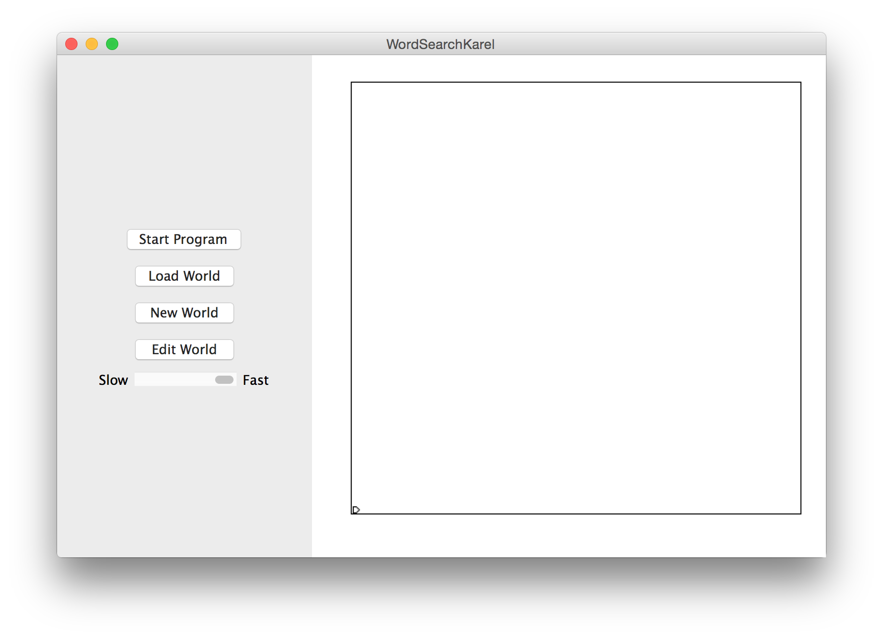

Slide 27
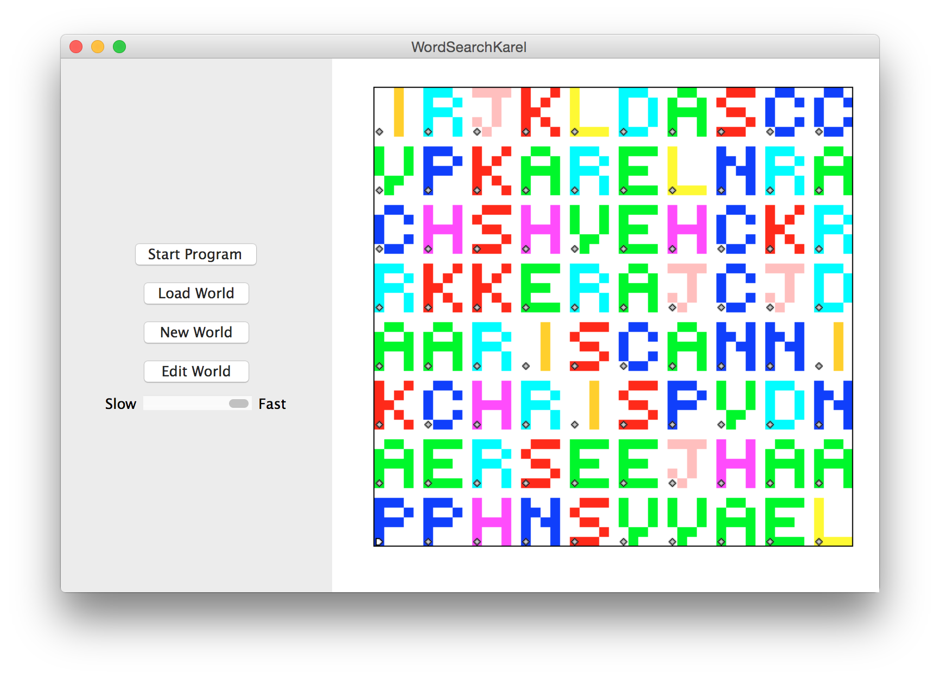

Slide 28
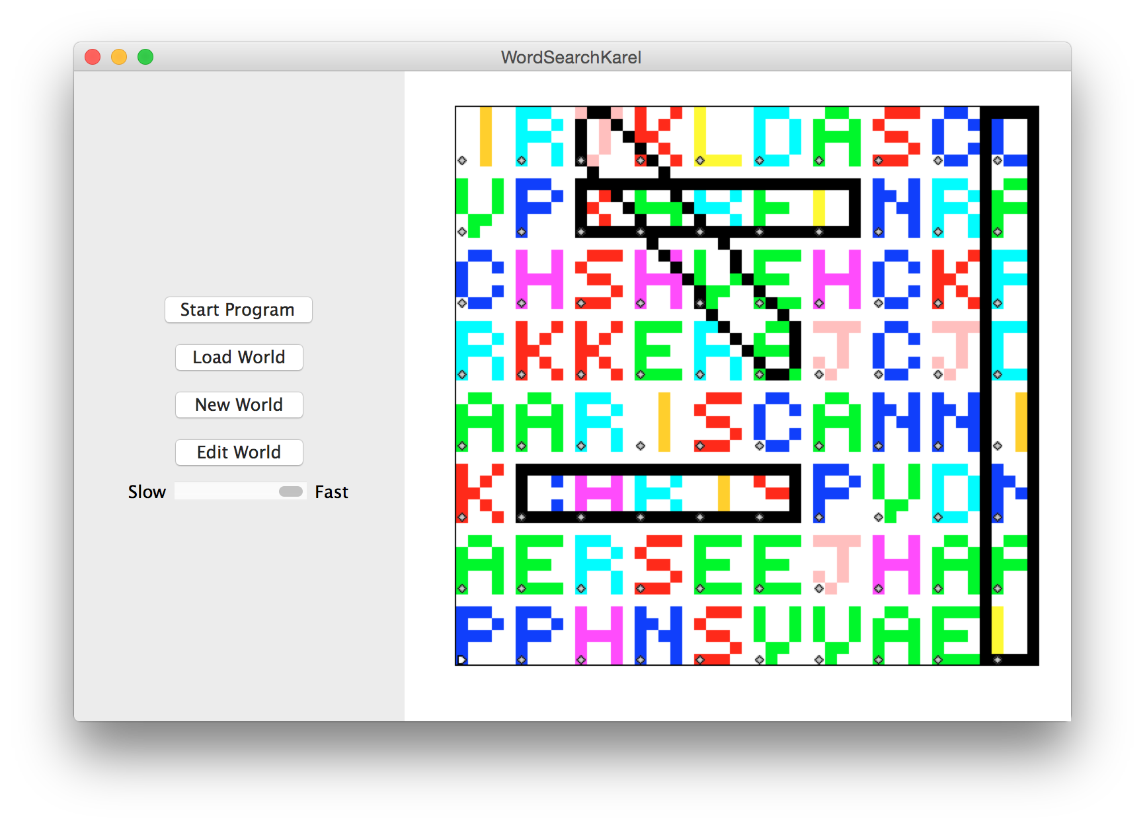

Slide 29
private void friday(){
banishWinter();
commonErrors();
decomposition();
doubleBeepers();
if(extraTime()){
wordSearchKarel();
}
}

Slide 30
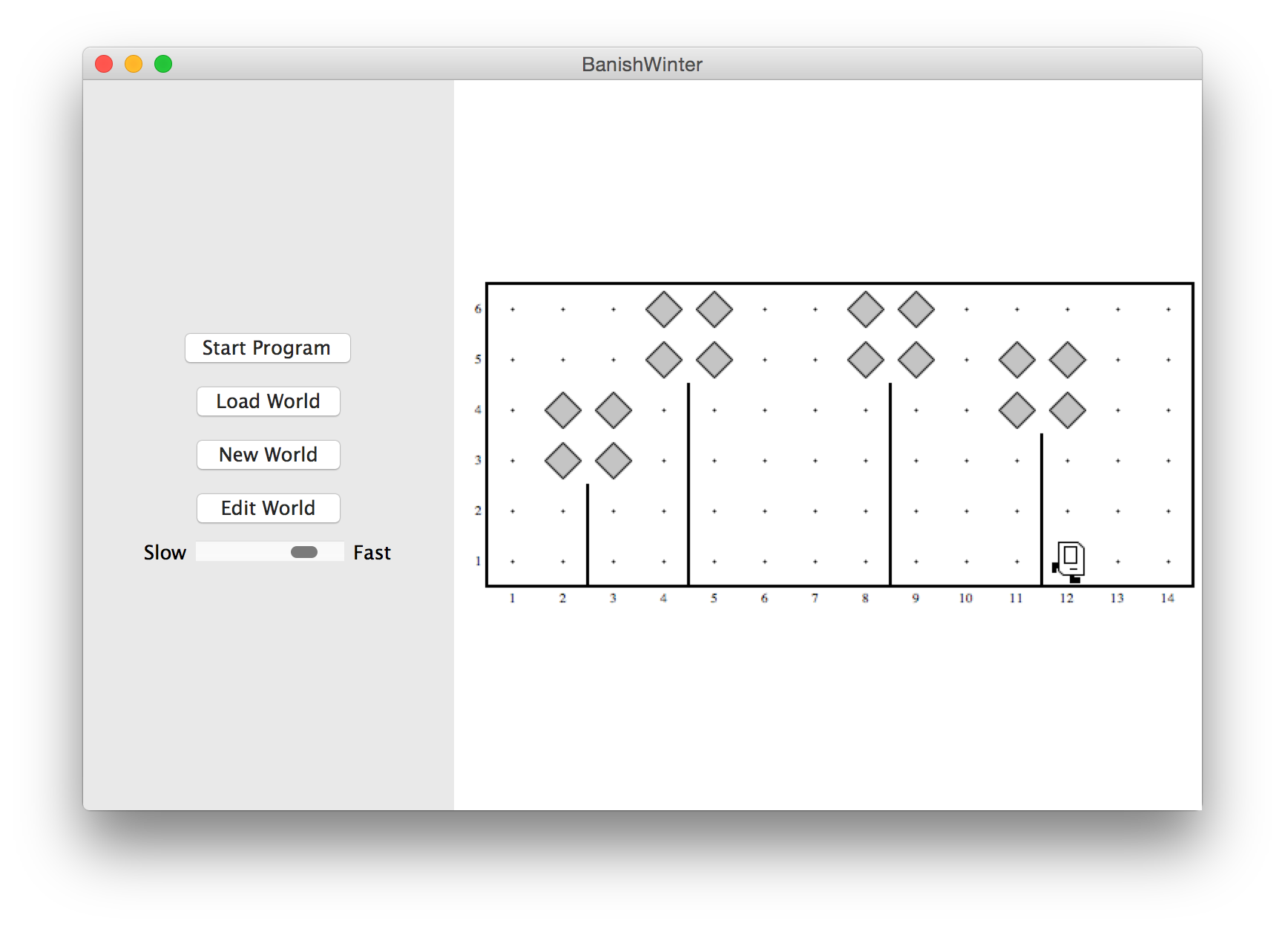
Banish Winter

Slide 31
private void friday(){
banishWinter();
commonErrors();
decomposition();
doubleBeepers();
if(extraTime()){
wordSearchKarel();
}
}

Slide 32
private void friday(){
banishWinter();
commonErrors();
decomposition();
doubleBeepers();
if(extraTime()){
wordSearchKarel();
}
}

Slide 33
Infinite Loop
Lather,
Rinse,
Repeat

Slide 34
Infinite Loop
private void turnToWall() {
while(leftIsClear()) {
turnLeft();
}
}

Slide 35
Infinite Loop
private void turnToWall() {
while(leftIsClear()) {
turnLeft();
}
}

Slide 36
Infinite Loop
private void turnToWall() {
while(leftIsClear()) {
turnLeft();
}
}

Slide 37
Infinite Loop
private void turnToWall() {
while(leftIsClear()) {
turnLeft();
}
}

Slide 38
Off By One
private void fillRow() {
while(frontIsClear()) {
putBeeper();
move();
}
}

Slide 39
Pre/Post that Don’t Match
private void addLeavesToTrees() {
turnLeft();
climbTree();
addLeaves();
descendToGround();
turnLeft();
}
Post: facing East
Pre: facing South

Slide 40
private void friday(){
banishWinter();
commonErrors();
decomposition();
doubleBeepers();
if(extraTime()){
wordSearchKarel();
}
}

Slide 41
private void friday(){
banishWinter();
commonErrors();
decomposition();
doubleBeepers();
if(extraTime()){
wordSearchKarel();
}
}

Slide 44
private void friday(){
banishWinter();
commonErrors();
decomposition();
doubleBeepers();
if(extraTime()){
wordSearchKarel();
}
}

Slide 45
private void friday(){
banishWinter();
commonErrors();
decomposition();
doubleBeepers();
if(extraTime()){
wordSearchKarel();
}
}

Slide 46
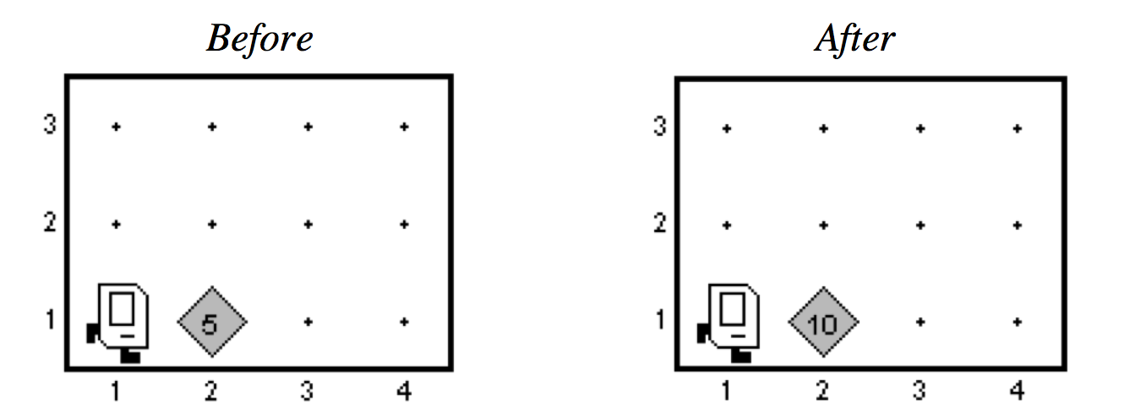
Double Beepers

Slide 48
private void friday(){
banishWinter();
commonErrors();
decomposition();
doubleBeepers();
if(extraTime()){
wordSearchKarel();
}
}

Slide 49
private void friday(){
banishWinter();
commonErrors();
decomposition();
doubleBeepers();
if(extraTime()){
wordSearchKarel();
}
}

Slide 50
private void friday(){
banishWinter();
commonErrors();
decomposition();
doubleBeepers();
if(extraTime()){
wordSearchKarel();
}
}

Slide 52
Happy Friday

